Slide 1
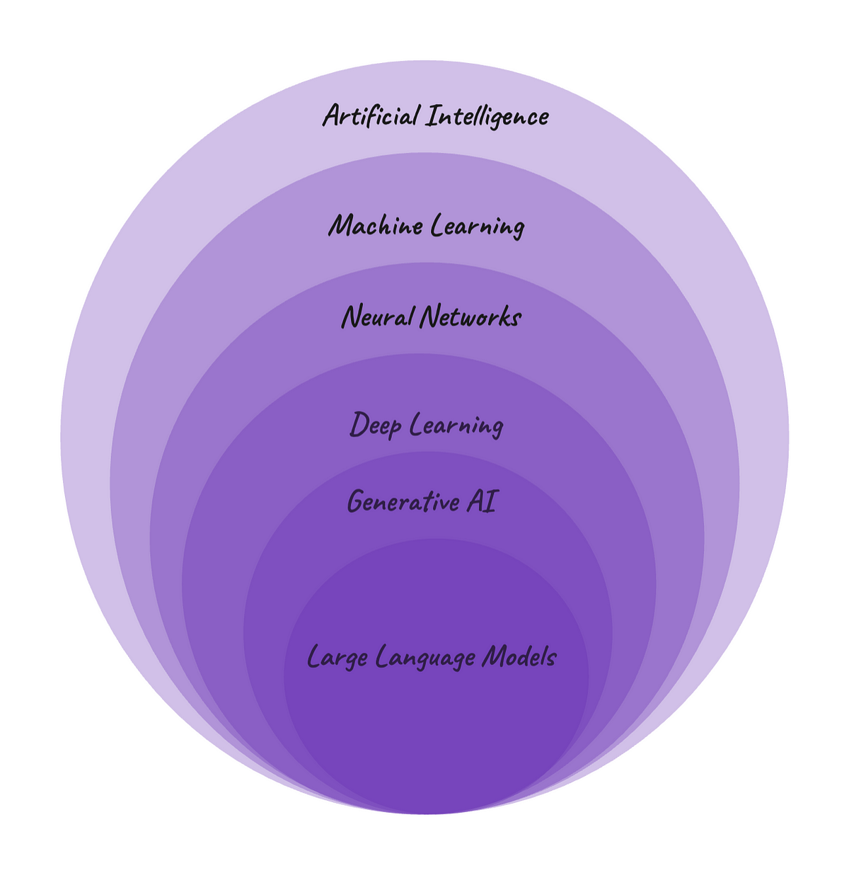
DATA SCIENCE
SUPERVISED LEARNING
UNSUPERVISED LEARNING
REINFORCEMENT LEARNING
MACHINE LEARNING
ARTIFICIAL ITELLIGENCE
GENERATIVE
Artificial Intelligence
NLP
stable diffusion
LLM MODELS
REGRESSION
CLASSIFICATION
DEEP LEARNING
CLUSTERING
OPEN AI
NEURAL NETWORK
CREW AI
GOOGLE
AI AGENTS
SUPER AGI
META
CLAUDE
Unfetch

Slide 2

What is stable diffusion ?
Stable Diffusion is a type of generative model primarily used for creating images from text descriptions.
It employs a process called diffusion, where it gradually transforms random noise into a coherent image by following a learned pattern from training data.
The model can generate high-quality visuals based on various prompts, making it popular for creative applications in art, design, and even game development.
Its ability to create detailed and diverse images has made it a significant tool in the realm of artificial intelligence.

Slide 3
REAL TIME USAGE OF STABLE DIFFUSION
1. Social Media Content Creation
Scenario: Influencers and marketers use Stable Diffusion to generate eye-catching images for social media posts.
Real-Time Use: By entering a prompt related to trending topics or themes, they can quickly create unique visuals that engage their audience, reducing the time needed for graphic design.
2. Video Game Asset Generation
Scenario: Indie game developers use Stable Diffusion to create concept art and character designs.
Real-Time Use: During brainstorming sessions, developers input descriptions of characters or environments to generate visuals instantly, helping the team visualize ideas more effectively and iterate rapidly.
3. Product Visualization
Scenario: E-commerce businesses leverage Stable Diffusion to visualize products in various settings or styles.
Real-Time Use: A fashion retailer can input descriptions of clothing items along with desired backgrounds, generating promotional images that showcase products in different contexts without the need for expensive photo shoots.
4. Art Generation for Streaming
Scenario: Artists streaming on platforms like Twitch use Stable Diffusion to create art live for their audience.
Real-Time Use: As they receive prompts from viewers, they can generate images on the spot, providing an interactive experience that engages their audience and showcases the capabilities of AI.
5. Storyboarding in Animation
Scenario: Animation studios use Stable Diffusion during the pre-production phase to visualize scenes and character designs.
Real-Time Use: Writers and directors input scene descriptions to generate storyboards quickly, allowing them to iterate on ideas and share visuals with the team.

Slide 4
HAND’S ON STABLE DIFFUSION PROJECT
PROJECT-1:
TEXT PROMPT TO IMAGE GENERATION USING GITHUB
PROJECT-2:
TEXT PROMPT TO IMAGE GENERATION USING HUGGING FACE & PYTORCH
PROJECT-3:
IMAGE GENERATION FROM MULTILANGUAGE TEXTPROMPT
OPEN-AI (GPT-4 Omini Model)
LANGTRAN
HUGGING FACE
STABLE DIFFUSION PIPELINE
PYTORCH

Slide 5
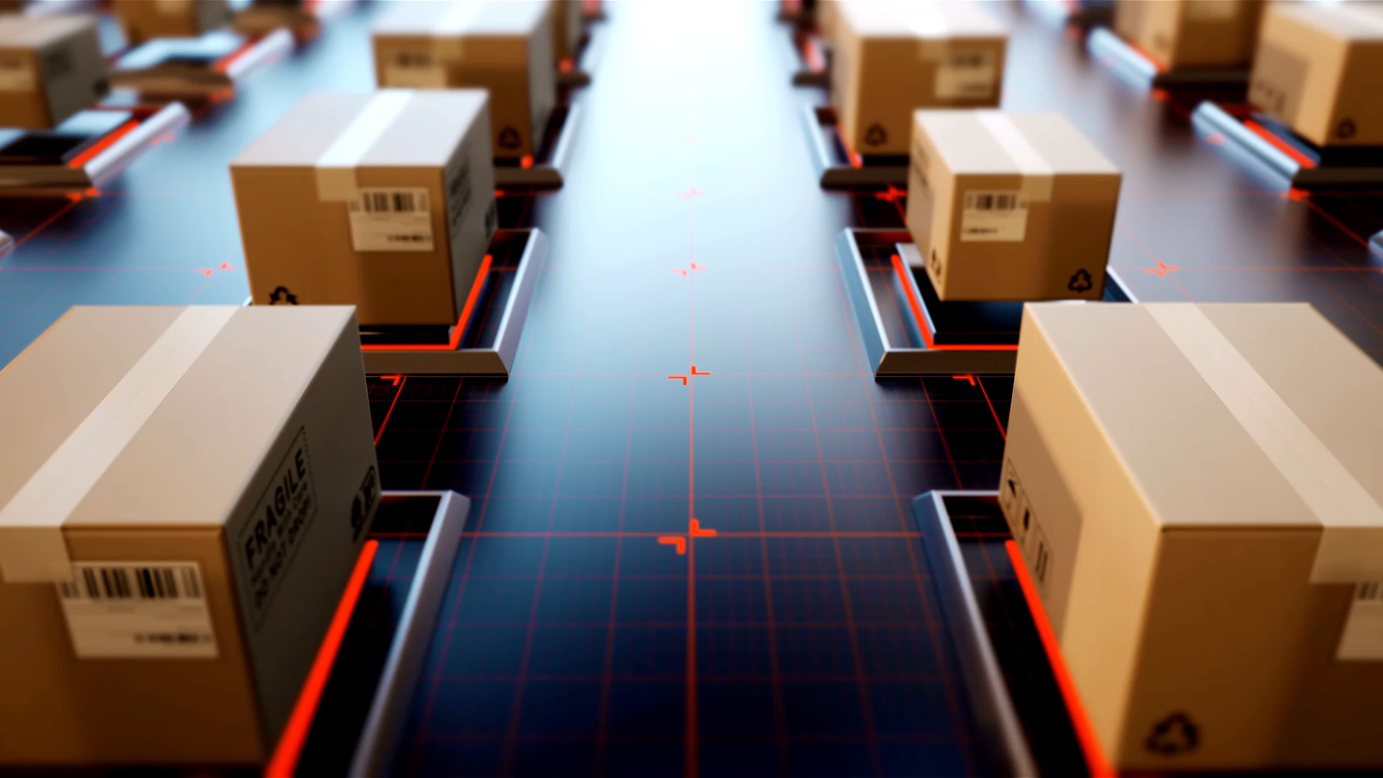
LET’S EXPLORE FEW WEBSITES WHICH INTEGRATE WITH STABLE DIFFUSON
Stable Diffusion Integration with Hugging Face: (stability/stable-diffusion) →
https://huggingface.co/spaces/stabilityai/stable-diffusion
Let’s understand from Wikipedia →
https://en.wikipedia.org/wiki/Stable_Diffusion
Stable Diffusion Github→
https://github.com/CompVis/stable-diffusion
CLIP MODEL & VAE AUTOENCODER & GENERATIVE AI→
youtube.com/watch?v=Xp1MnygECUs&t=6174s
Stable diffusion hugging face model →
image_gen_model_id = "stabilityai/stable-diffusion-2-1"

Slide 6
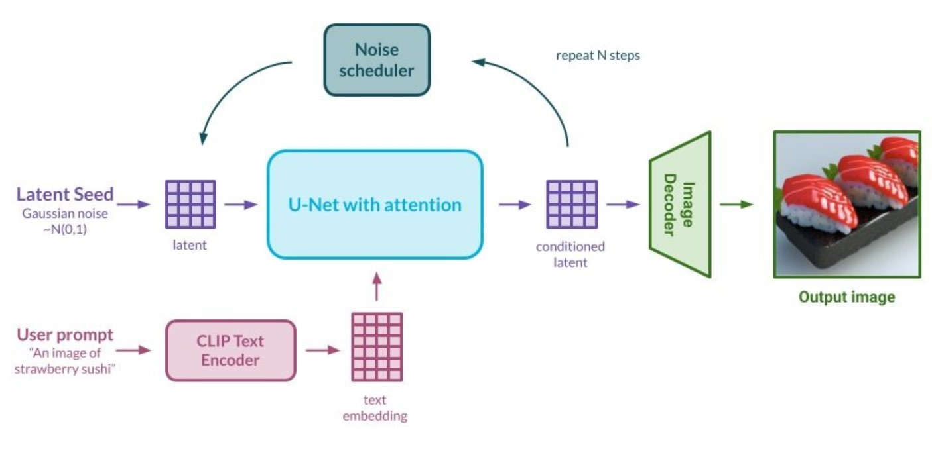
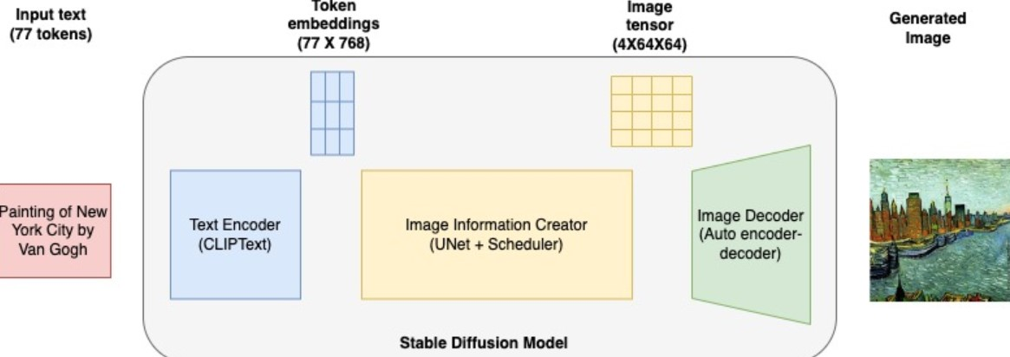
STABEL DIFFUSION ARCHITECTURE

Slide 7
STABLE DIFFUSION ARCHITECTURE EXPLANATION: 1
The process of generating an image from a text prompt, specifically a strawberry sushi image, using a diffusion model. Diffusion models are a class of generative models that learn to gradually denoise noise-corrupted
1. CLIP Text Encoder:
Purpose: This component encodes the text prompt "An image of strawberry sushi" into a numerical representation, or embedding.
How it works: The encoder uses a pre-trained model like CLIP (Contrastive Language-Image Pre-training) to understand the meaning of the text and convert it into a format that the model can process.
2. Latent Seed:
Purpose: This is a random vector of numbers that serves as the starting point for the image generation process.
How it works: The latent seed is initialized with Gaussian noise, meaning it's filled with random values drawn from a Gaussian distribution.
3. Noise Scheduler:
Purpose: This component determines the amount of noise to add or remove at each step of the generation process.
How it works: The noise scheduler follows a pre-defined schedule, gradually decreasing the amount of noise over time.
4. U-Net with Attention:
Purpose: This is the core of the diffusion model, responsible for denoising the latent seed.
How it works: The U-Net is a deep neural network architecture that learns to predict the noise pattern present in the latent seed. It uses attention mechanisms to focus on relevant parts of the image.

Slide 8
STABLE DIFFUSION ARCHITECTURE EXPLANATION:2
5. Decoder:
Purpose: This component converts the denoised latent representation into a pixel-level image.
How it works: The decoder uses a neural network to map the latent representation to the corresponding pixel values of the output image.
6. Repeat N Steps:
Purpose: This indicates that the denoising process is repeated multiple times (N steps) to gradually refine the image.
How it works: At each step, the U-Net predicts the noise, and the noise scheduler updates the latent seed accordingly.
Overall Process:
Encoding: The text prompt is encoded into a numerical representation.
Initialization: A latent seed is initialized with Gaussian noise.
Denoising: The U-Net iteratively denoises the latent seed, guided by the noise scheduler and the text embedding.
Decoding: The denoised latent representation is decoded into an image.
The final output is an image of strawberry sushi, generated based on the text prompt and the learned patterns in the diffusion model.

Slide 9
HUGGING FACE & PY-TORCH
Hugging Face is a company that provides tools and resources for building llm applications for generative ai & hugging face most notable for its Transformers library.
The company also has a platform that allows users to share pre trained models and datasets and showcase their work.
Transformers library: This library provides a set of pre-trained models and tools for a variety of NLP tasks, including text classification, question answering, and machine translation.
Hugging Face Hub: This platform allows users to share and discover machine learning models, datasets, and other resources.
Datasets library: This library provides a collection of pre-processed datasets for a variety of machine learning tasks.
Training and evaluation tools: Hugging Face provides tools for training and evaluating machine learning models.
HUGGING FACE AUTH TOKEN CREATION : https://huggingface.co/settings/tokens
HUGGING FACE WITH GPT-OMINI MODEL: https://huggingface.co/gpt-omni/mini-omni
SAVE THE MODEL WITH : gpt-omni/mini-omni
PYTORCH →
PyTorch is a popular open-source machine learning library primarily used for deep learning applications. Using pytorch create tensors, Neural Network, optimizer, Data loading, dynamic computation graph, Tensors & Gpu Excelaration, custom loss function, pre build layers & modules, model training & evaluation.
PYTORCH DOCUMENTATION : https://pypi.org/project/torch/
PYTORCH GITHU : https://github.com/pytorch/pytorch

Slide 10
GENERATIVE AI PREVIOUS RECORDING SESSION
1- ChatGPT Tutorial for Developers | Introduction to ChatGPT : youtube.com/watch?v=SDStCnlITT8
2- Generative AI Workshop : youtube.com/watch?v=Xp1MnygECUs
3- LARGE LANGUAGE MODEL : youtube.com/watch?v=v0w9LXXrsys
4- COMPLETE DATA SCIENCE LIBRARY: youtube.com/watch?v=MsFhUjFL4vE&t=209s
5- Know About Data Science & Generative AI: youtube.com/watch?v=TR_OCx5z-m8
6- Generative AI with Langchain, Langsmith, OpenAI & LLMops : youtube.com/watch?v=MAkXifYHnuw&t=1320s
7- Google Generative AI | Gemini AI: youtube.com/watch?v=BDrXdvNh19Q&t=5684s
8- Gen AI for Build LLM Model Using Lama 3,Hugging Face & Ollama : youtube.com/watch?v=eDN6fAWLNNE&t=5425s
9- GEMMA-9B Integration with GROQ, HUGGINGFACE & LANGCHAIN: youtube.com/watch?v=Bp1XyvMvedg&t=7086s
10- NLP: youtube.com/watch?v=s-xhKH-e8ig&t=5844s
11- RAG: www.youtube.com/watch?v=8nWjvn8ZKtU&t=7553s
12- CREW AI: https://www.youtube.com/watch?v=0gqlrw-6I0s
13- STABLE DIFFUSION : https://www.youtube.com/watch?v=c1GqJ-VFLW0

